Slide 1
Platform for Improving Searchability and Interactivity for Recorded lectures
V-Tutor
Your classroom brought closer

Slide 2
Group Members D. C. Karunaratna H. A. I. S. Hettiarachchi S. S. Epa S. S. M. S. Fernando Supervisor Dr. Nuwan Kodagoda Co-Supervisor Ms. Kushnara Suriyawansa

Slide 3
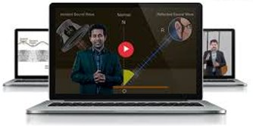
Introduction
Many Universities provide the facility to view pre-recorded lectures online
Benefits
Allows teachers to save hours of repetitive teaching.
Re-watch Complicated lectures
Students can learn at their own pace
2

Slide 4
Research Problem
When viewing online lecture videos students come across a few problems.
Video lectures are usually lengthy and tedious to watch.
Poor searchability through the video
Less interaction with the student
Not directly connected to other supporting material such as Lecture slides and Tutorials
Many of the existing tools to improve lecture quality require human intervention which is time consuming
4

Slide 5





Existing Systems
8

Slide 6
Feature Comparison
Features​ | echo360​ | TechSmith Relay​ | Camtasia​ | LearnWorlds​ | Proposed System​
Automatically matching code samples to occurrence in recorded lecture​ | ✗​ | ✗​ | ✗​ | ✗​ | ✔​
Automatically divide video into topic units​ | ✔ | ✗​ | ✗​ | ✗​ | ✔​
Automatically match lecture slides with the recorded video​ | ✔ ​ | ✔ | ✔ | ✗​ | ✔​
Automatic question generation​ | ✗​ | ✗​ | ✗​ | ✗​ | ✔​

Slide 7
Solution
V-Tutor
Your classroom brought closer
Platform for Improving Searchability and Interactivity for Recorded lectures

Slide 8
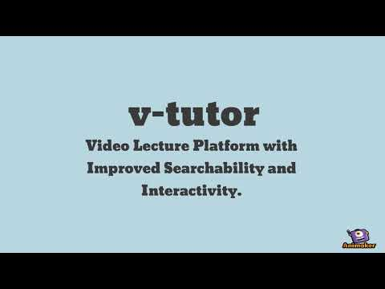
Introduction Video

Slide 9
Main Objectives
Make a lecture video sharing platform which requires minimum user intervention to create new content.
Give users the ability to search through lecture videos by using lecture slides and source code as indexes.
Segment each lecture into topics based on the video content.
5

Slide 10
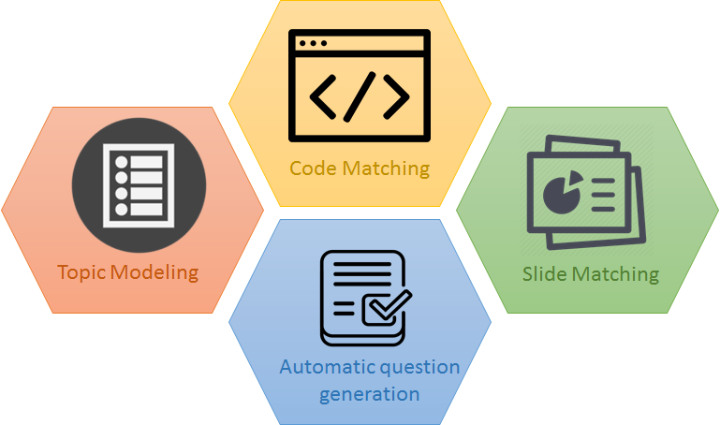
System Modules

Slide 11










How it Works?
Upload
Processing
Review
Publish
Navigate using slides, code samples and topics
Answer MCQs based on video content
Register
(Lecturers + Students)
Interactive Video

Slide 12


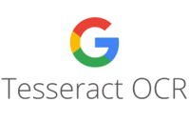



Technologies Used
6

Slide 13
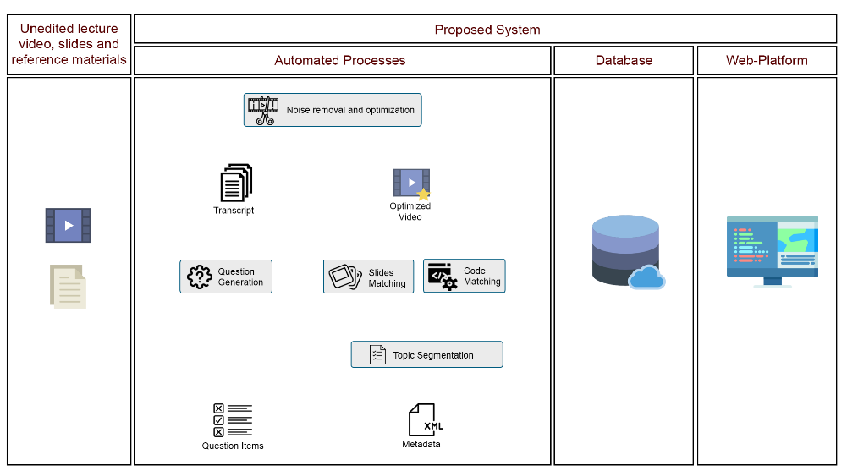
System Architecture

Slide 14
Uniqueness
The application utilizes a cloud-based architecture and is hosted on the Amazon Web Services cloud platform.
features are not seen in any of the competing products
Automatic Lecture slide matching
Automatic code matching.
Automatic Topic Generation and segmenting the video based on topic transitions
Automatic MCQ generation

Slide 15
Business Potential
Potential Business Models
Plugin for several existing MOOCs and LMSs
Software as a Service (SaaS) product, where the customer will pay a one-time fee or monthly subscription or as a freemium model
Advertisements can be incorporated into a web application.
Achievable user benefits
The system will fully automate otherwise tedious manual processes involved in creating lectures.
Enhanced online lectures which are tied in seamlessly with supporting content.

Slide 16
Business Model Canvas
Key Partners
Key Activities
Value Prepositions
Customer Relationships
Customer Segments
Learning Institutions such as universities & institutes
Syncing lecture videos with other lecture materials
Save time and effort in creating interactive course material
Any institute/ university that use recorded lecture videos to enhance the learning process
Online Tutorial/ Demonstrations
Easily navigate through lecture videos with lecture materials and topics
Social Media Interaction
Key Concepts
Channels
"VTutor" Web Platform
Web Application
Enhance learner engagement through embedded questions
Lecture Materials
Embedded in LMS
Cost Structure
Revenue Streams
Hosting application on Amazon cloud
Subscription fees from universities and institutes
Marketing/ Advertisements
Social Media Marketing
Product Development

Slide 17
Demonstration

Slide 18
Thank You

